Slide 1


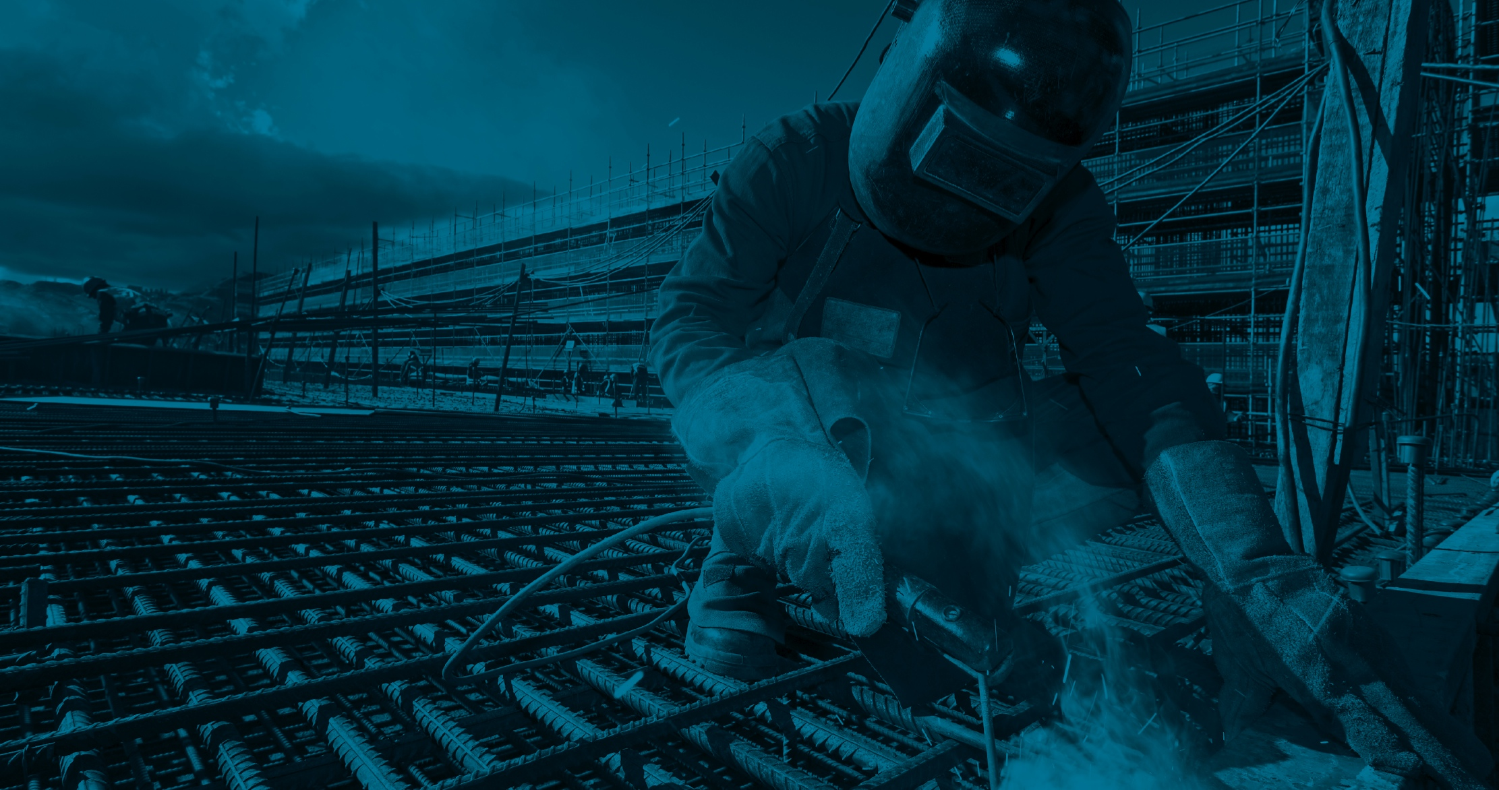



Toolbox talk - Welding
IMPORTANT NOTE TO MANAGERS
The job has been designed to minimise the amount of welding required on site.
You have undertaken a task specific risk assessment and determined the control measures, including a suitable type of respiratory protection.
If you are providing respiratory protection you have or will arrange face fit testing.

Slide 2
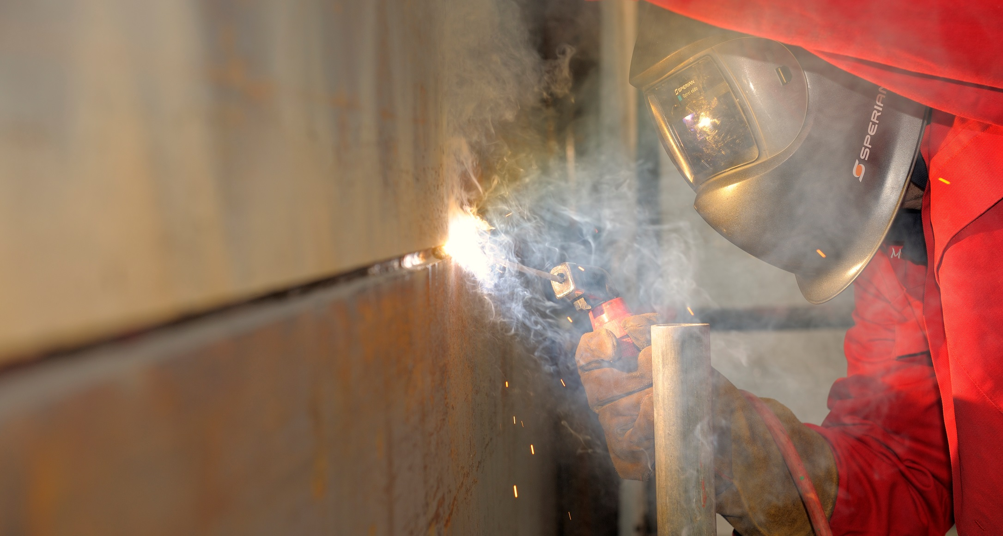


Toolbox talk - Welding

Slide 3


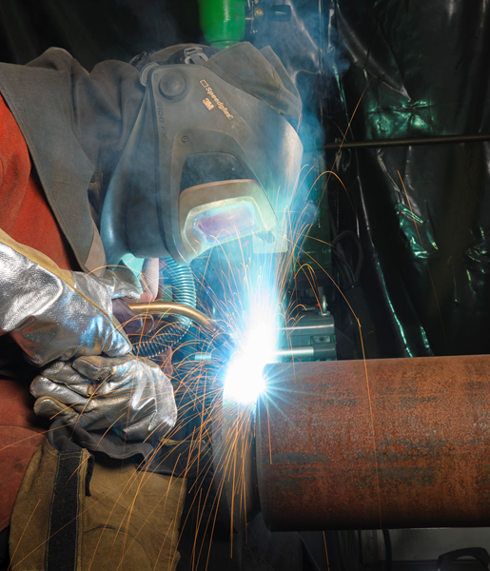
Toolbox talk - Welding
The welder is being exposed to welding fume and gases, which are not being properly controlled.
Breathing welding fume can be harmful to health, and is often underestimated. The constituents of the fume will depend on:
the type of welding.
the base metal being welded or filler metal being worked into the weld.
any surface coating (e.g. zinc, chrome or cadmium) or contamination such as paints or oils.
The fumes from welding stainless steel (contains chromium and nickel) and specialist metals which contain cadmium or beryllium are particularly dangerous.
Bad practice picture required

Slide 4
Toolbox talk - Welding
Welding fume contains a cocktail of airborne gases and very fine particles.
The visible part of the fume cloud is mainly made up of very fine particles of metal, metal oxide and flux. If inhaled, these can cause ill health.
The gases can include carbon monoxide, nitrous oxides, ozone (especially when welding aluminium), and shielding gases, such as argon or helium.
Health effects depend on the amount and type of fume created and how long you are exposed for. Occasional tack welding outside is unlikely to cause a problem, but extensive welding in poorly ventilated areas can seriously damage your health.
Bad practice picture required

Slide 5
Toolbox talk - Welding
Short-term health effects include:
Respiratory irritation of the throat and lungs (especially from ozone created during tungsten inert gas (TIG) welding of stainless steel and aluminium).
Temporary reduced lung function, e.g. where breathing is easier when not working, at the weekend, for example, than during the week.
Metal fume fever, which has similar symptoms to flu and can be caused by high fume levels from welding galvanised metal or, in some cases, mild steel.
Bad practice picture required

Slide 6
Toolbox talk - Welding
Long-term health effects include:
Asthma, particularly when working with stainless steel which contains nickel and chromium.
Cancer, particularly when welding metals containing nickel and chromium (such as stainless steel) and specialist metals that contain cadmium or beryllium.
Nervous system damage from manganese, which is found in many welding rods, including those used with mild steel.
Pneumonia, welders are particularly prone to a lung infection that can lead to severe, and sometimes fatal, pneumonia.
Bad practice picture required

Slide 7

Toolbox talk - Welding
Where we can, we will protect you by:
Reducing the amount of fume.
Ensuring good ventilation (mechanical and natural).
Providing suitable respiratory protection where needed.

Slide 8
Toolbox talk - Welding
The best way to reduce fume is to design the job to minimise the amount of welding required in the facility, using:
Other methods of fixing, such as old fashioned nuts, bolts, rivets.
One of the ever developing range of adhesives.
Pre-fabricated structures.
Where welding is essential, we can design the job to use techniques which produce the least fume, such as TIG instead of metal inert gas (MIG) or manual metal
arc (MMA) welding.

Slide 9
Toolbox talk - Welding
Good control practice for welding fume (as per HSE’s Welding Fume Control document WL3)
Frequency and duration of welding | Type of welding | Good control practice
Sporadic low – intensity welding | Gas, MMA, FCA, MIG, MAG | LEV where reasonably practicable. Otherwise good general ventilation and RPE
Regular and/or high-intensity welding | Gas, MMA, FCA, MIG, MAG | LEV and consider supplementary RPE
Regular and/or high-intensity welding outdoors in the open air | Gas, MMA, FCA, MIG, MAG, TIG | RPE where LEV is not reasonably practicable
Sporadic low-intensity welding | TIG and resistance spot welding | Good general ventilation
Regular and/or high intensity welding | TIG and resistance spot welding | LEV

Slide 10
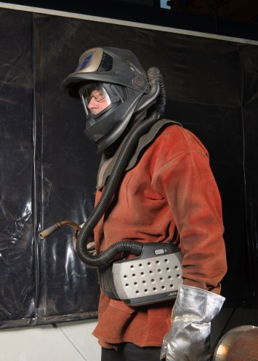
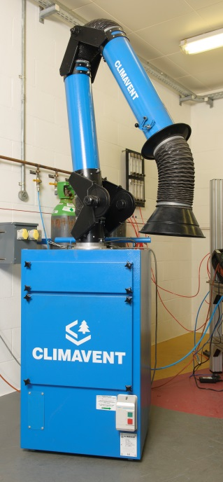
Toolbox talk - Welding
We can improve ventilation by:
Moving the structure outside, or to a well ventilated area if possible.
Using fume extraction.
Adding extra mechanical ventilation if required.

Slide 11
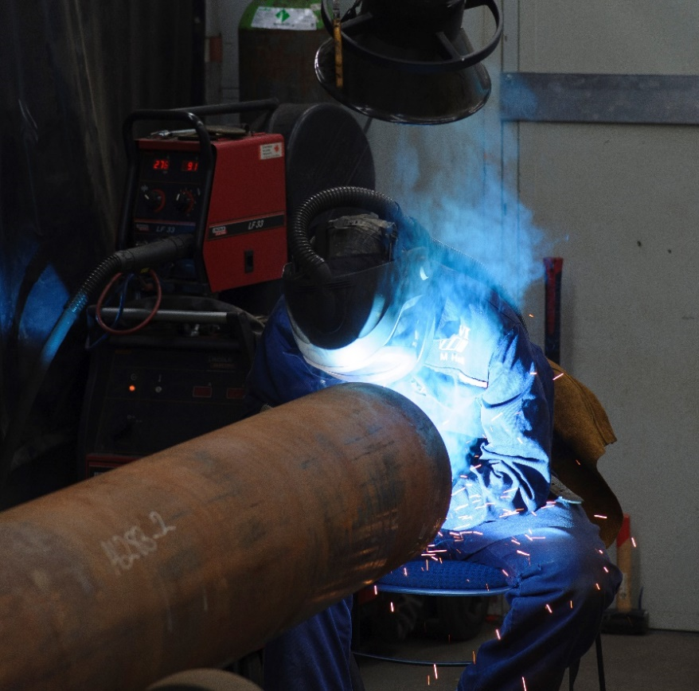
Toolbox talk - Welding
Where flexible arm fume extraction is used, the position of the extraction hood is crucial! If too far away, it has no benefit; it typically needs to be placed within 30cm of the welding source although this range may be much shorter. And so it is important that the system's capture range is identified during commissioning and further routine testing of the LEV system.
Also, in some cases, if positioned incorrectly, it can draw the fume across the welder and increase exposure to fume and gases.
This type of extraction can work well for small welding jobs, but for long sections of weld other means of control are necessary, such as on-torch extraction or respirators.

Slide 12
Toolbox talk - Welding
We will supply respiratory protection
where it is not practical to use other controls, or where additional protection is needed. This can range from simple face masks to filtered air visors to air fed visors in high risk situations.

Slide 13
Toolbox talk - Welding
We will train you:
Not to weld dirty or painted surfaces, but clean off the coating first and being careful to further remove any residual degreaser solvents from the surface of the metal component before welding. Otherwise, welding onto this solvent residue more produce toxic gases and vapours.
Not to clean coatings using burning or grinding, because these can cause the same problems of dust or fume.
To use welding techniques which can reduce the amount of fume breathed in, for example standing over the weld will cause the hot fumes to envelop your visor and increase the amount of fume you breathe in.

Slide 14

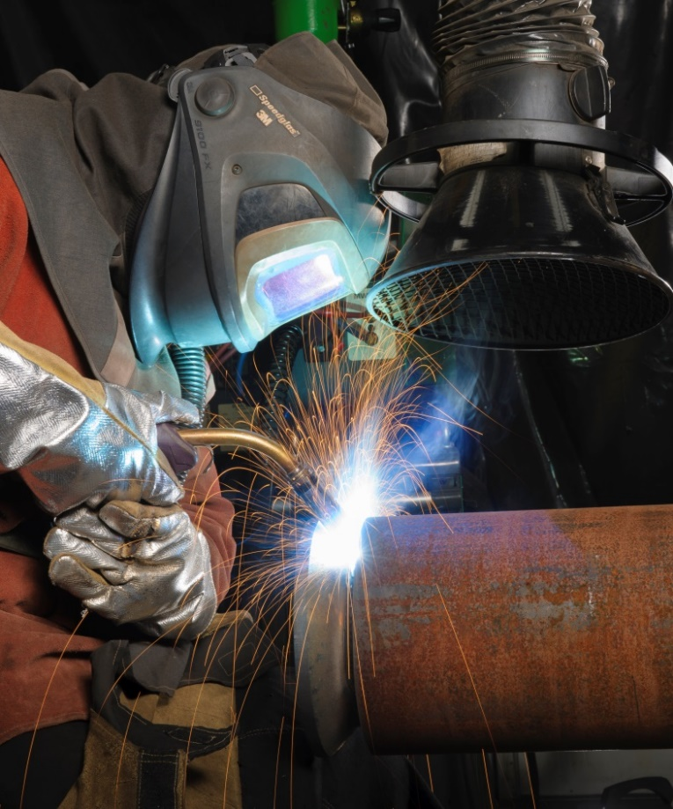
Toolbox talk - Welding
Always read and understand the risk assessment before starting work.
Be aware of the risks from breathing welding fume.
Know what you are welding – simple mild steel or more dangerous metals, such as stainless steel.
Check that the surface is clean.
Understand whether a particular job is low risk, such as occasional tack welding outside, or high risk, e.g. extensive welding in an area with poor ventilation.
Never weld in a confined, poorly ventilated space without protection.
Use the control measures correctly – especially local extraction and respiratory protection.
Make sure you position moveable extraction hoods so they capture the fume properly.
Be aware of other workers who could breathe in your weld fume (an exclusion zone must be in place surrounded by flame-retardant sheeting).
Good practice picture required

Slide 15

Toolbox talk - Welding
1
What are the effects of breathing in welding fume?
Short-term effects include throat and lung irritation, temporary reduced lung function, and metal fume fever.
Long-term effects include asthma, pneumonia, cancer, and damage to the nervous system.
2
What three factors are likely to lead to high fume exposure?
High volume welding.
Poor ventilation.
Undertaking welding types which produce large amounts of fume, e.g. MIG or MMA, as opposed to welding types which produce smaller amounts of fume e.g. TIG.
3
Do you have everything you need to protect yourself?
Read and understand the risk assessment, which should cover the specific welding activities as relevant.
Choose alternative fixing/joining methods or prefabrication over welding where possible.
Check there is good ventilation.
If in doubt use fume extraction, and use it close enough to capture the fume.
Know how and when to use a suitable respirator for additional protection, and make sure it’s in good working order.
Be aware of other workers nearby who could breathe in welding fumes as you work.

Slide 16

Toolbox talk - Welding

Slide 17
Toolbox talk - Welding
Visual standards demonstrate ‘what good looks like’.
They are intended to reinforce expectations of health and safety standards.

Slide 18

Toolbox talk - Welding
Work is designed to avoid welding where possible, choosing other fixing methods or prefabrication where possible.
Good ventilation methods are used, such as fume extraction or working in a well ventilated area.
On-torch extraction is effective at controlling fume for MIG welding. Back-draught partial enclosures may be more suitable for other situations. If moveable arm extraction is used, it must be positioned very carefully (as in the photograph).
Suitable respirators are used for additional protection.
Welders are aware of other workers nearby who might be at risk of breathing in welding fume.
Further information: www.hse.gov.uk/pubns/guidance/wlseries.htm
https://www.breathefreely.org.uk/WST/

